Slide 1

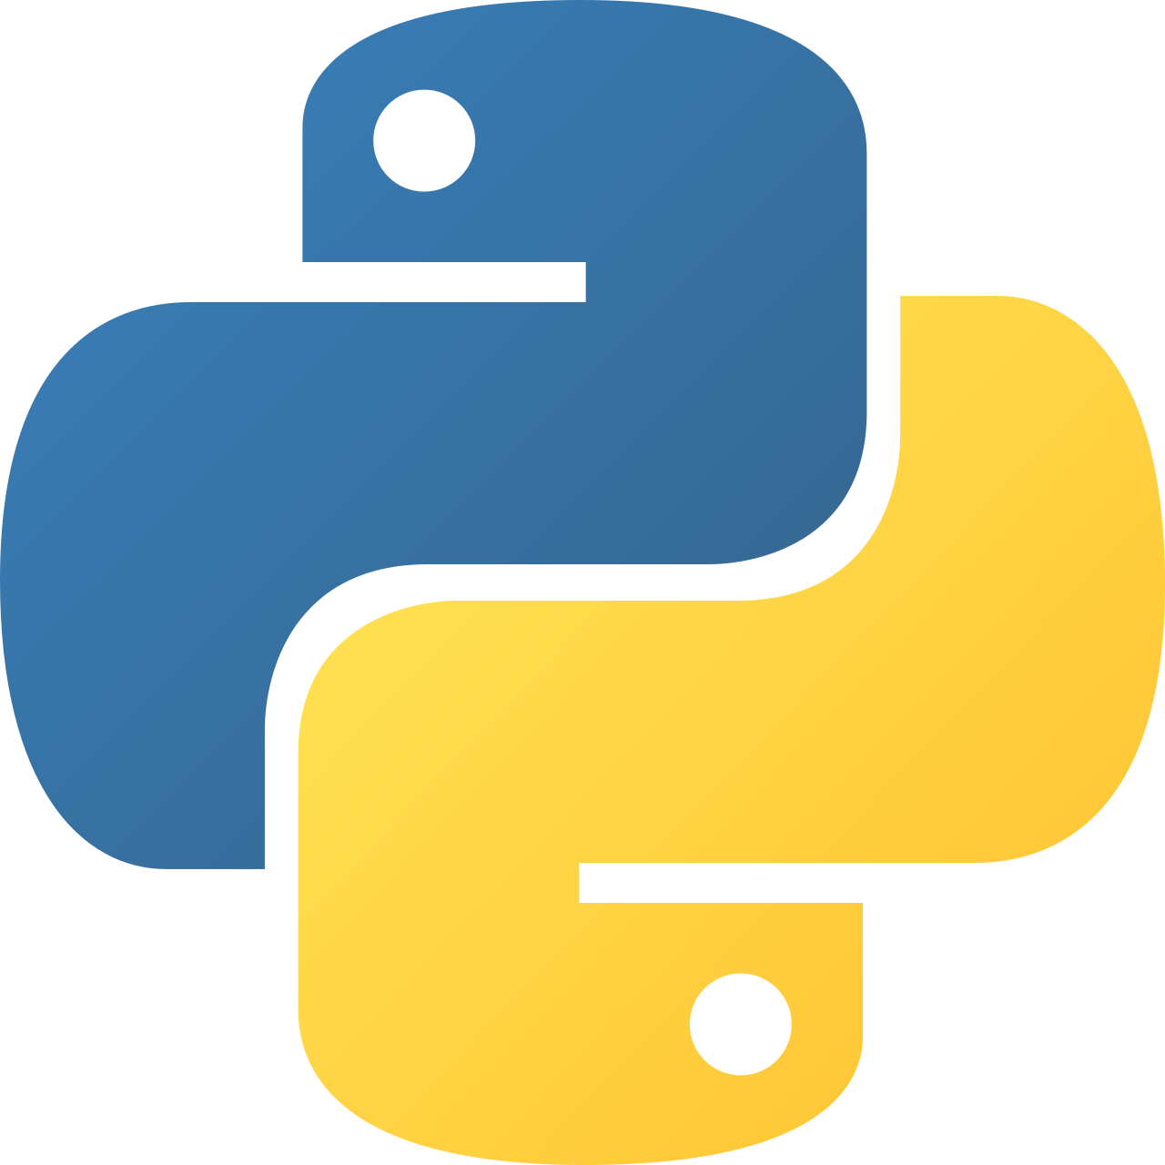
Intermediate Python
File System & Serialization

Slide 2
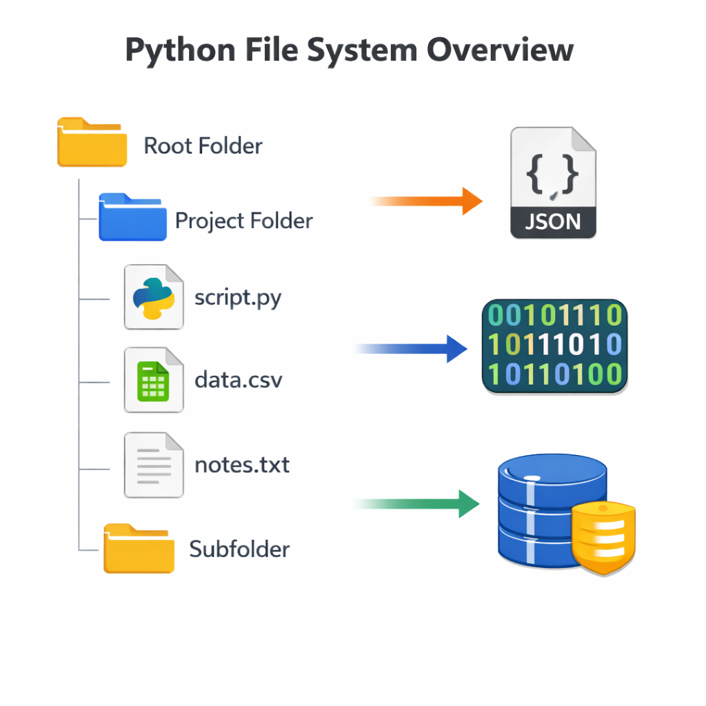
File System & Serialization Overview
How Python reads, writes, structures, and persists data beyond memory.
Programs lose data when they stop unless persisted
Filesystem APIs let Python interact with the OS
Serialization converts objects into storable formats
Different formats serve different use cases
Choosing the wrong method causes bugs or security risks
Notes:
This session moves students from in-memory thinking to persistent systems. Emphasize that data lifetime is a core design concern.

Slide 3
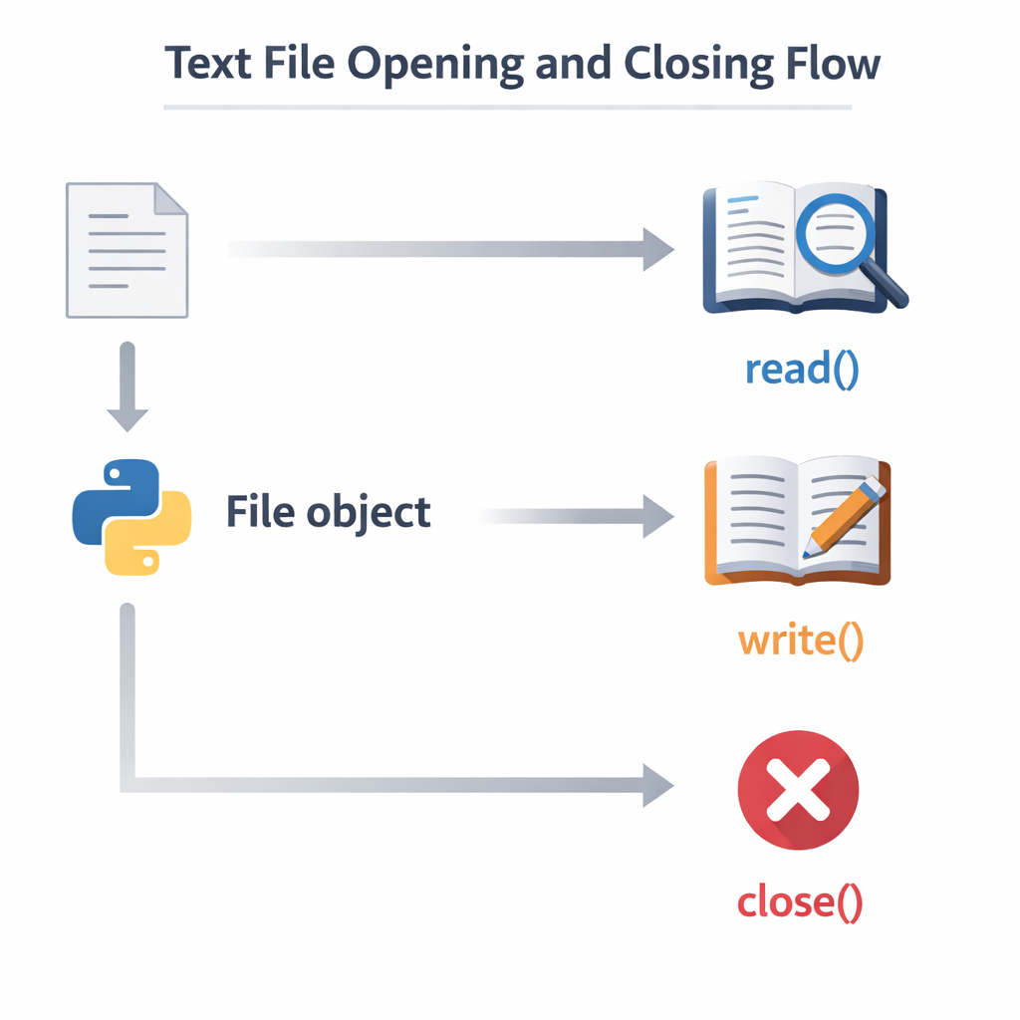
File I/O Fundamentals
The foundation of persistence: reading from and writing to files.
Files are streams of text or bytes
Modes control behavior: read, write, append, binary
Context managers ensure safe file handling
Encoding matters for text data
Errors occur at OS boundaries (missing files, permissions)
Notes:
Stress the importance of closing files properly and why with exists conceptually (no code shown here).

Slide 4
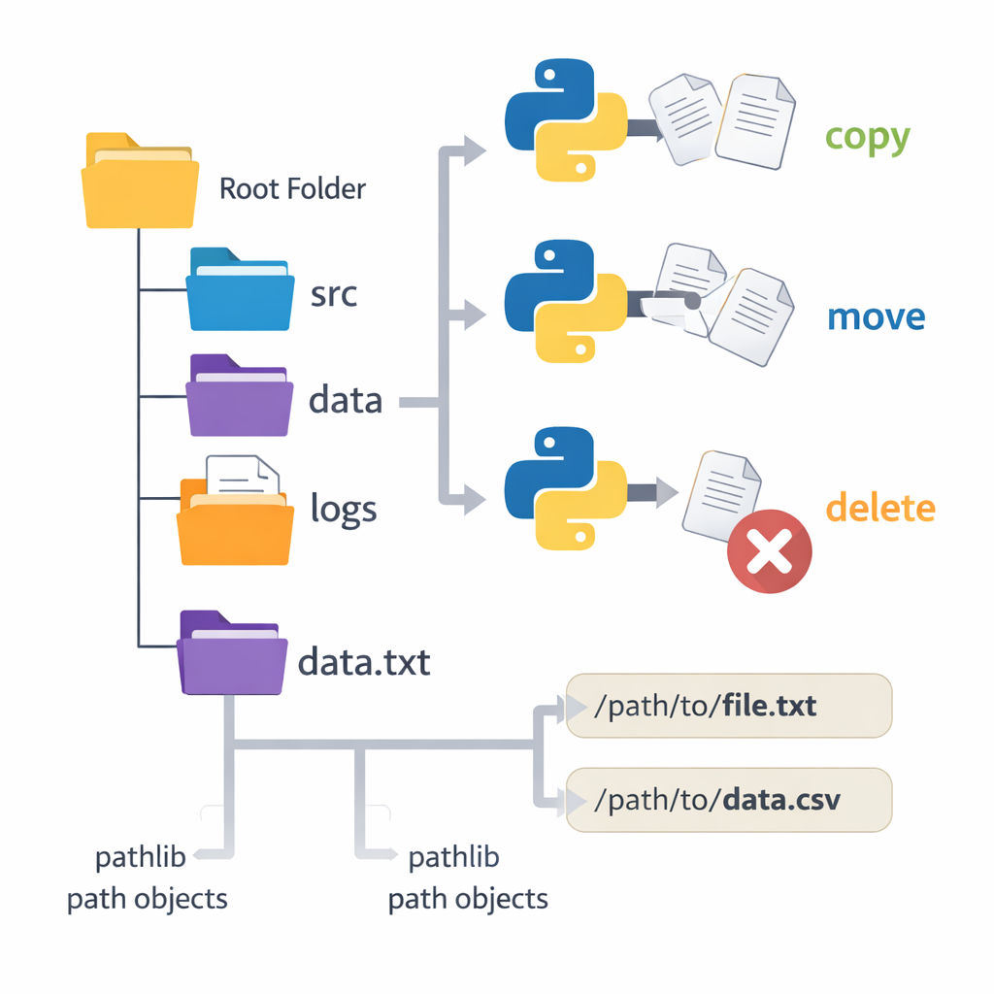
OS-Level Tools: os, shutil, pathlib
Python tools for working with files and directories safely.
os exposes low-level operating system features
shutil handles file copying, moving, deleting
pathlib provides object-oriented path handling
Path portability matters across OSes
Prefer pathlib for modern Python design
Notes:
Highlight evolution: os → shutil → pathlib. Explain why abstractions matter more than memorizing APIs.

Slide 5
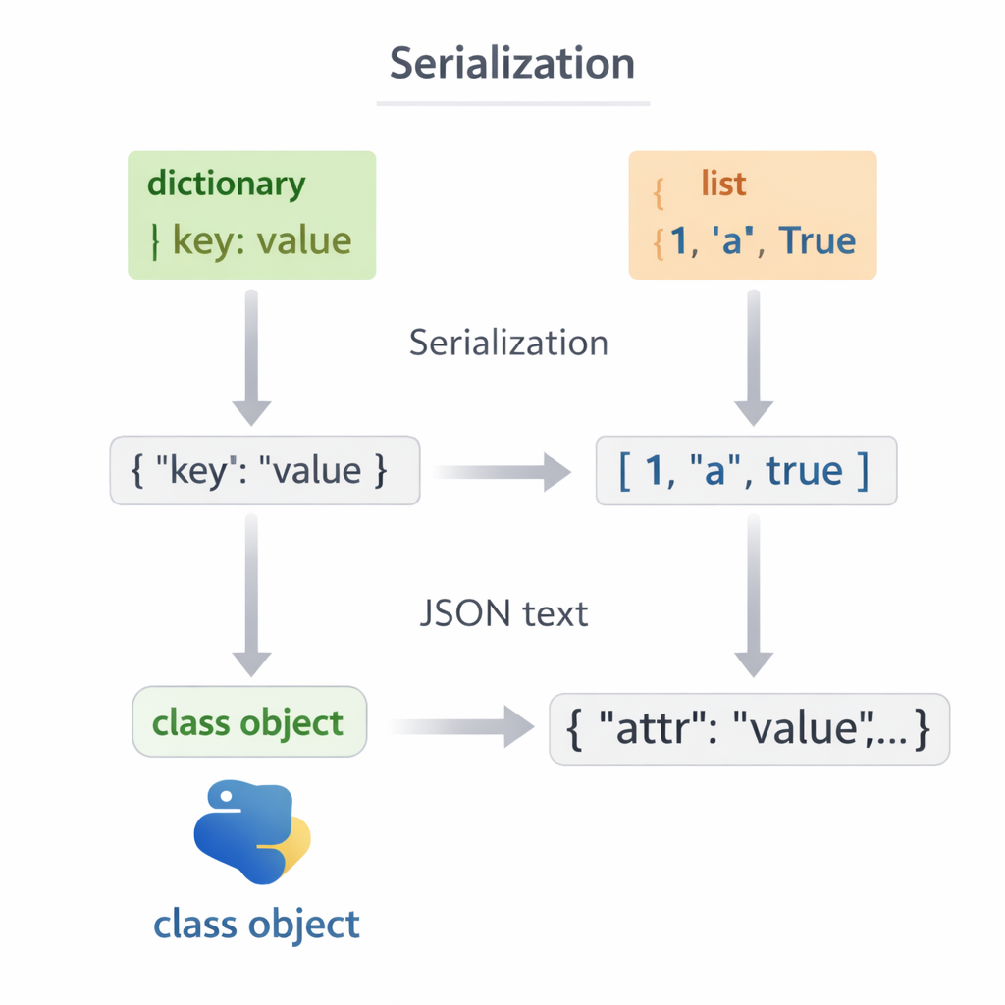
JSON Serialization
Human-readable data exchange between systems.
JSON stores dictionaries, lists, numbers, strings
Language-agnostic and widely supported
Ideal for configs, APIs, simple persistence
Cannot store functions or custom objects directly
Easy to debug and inspect manually
Notes:
Reinforce that JSON is for data, not behavior. Great place to discuss validation and schema awareness.

Slide 6
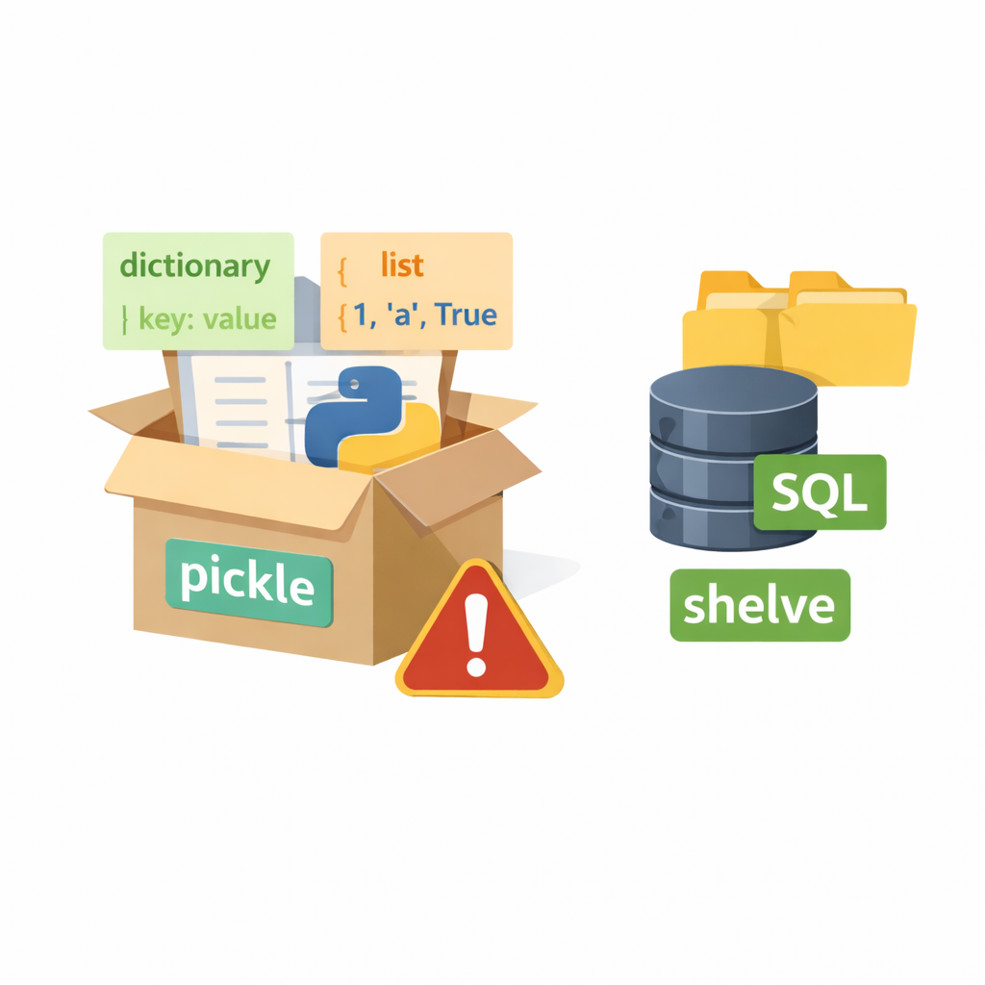
Pickle & Shelve
Python-native object persistence with power and risk.
pickle serializes almost any Python object
shelve provides dictionary-like persistence
Objects restore state exactly as saved
Not human-readable
Unsafe with untrusted data
Notes:
This is a critical security teaching moment. Make it clear: pickle is convenience, not safety.

Slide 7
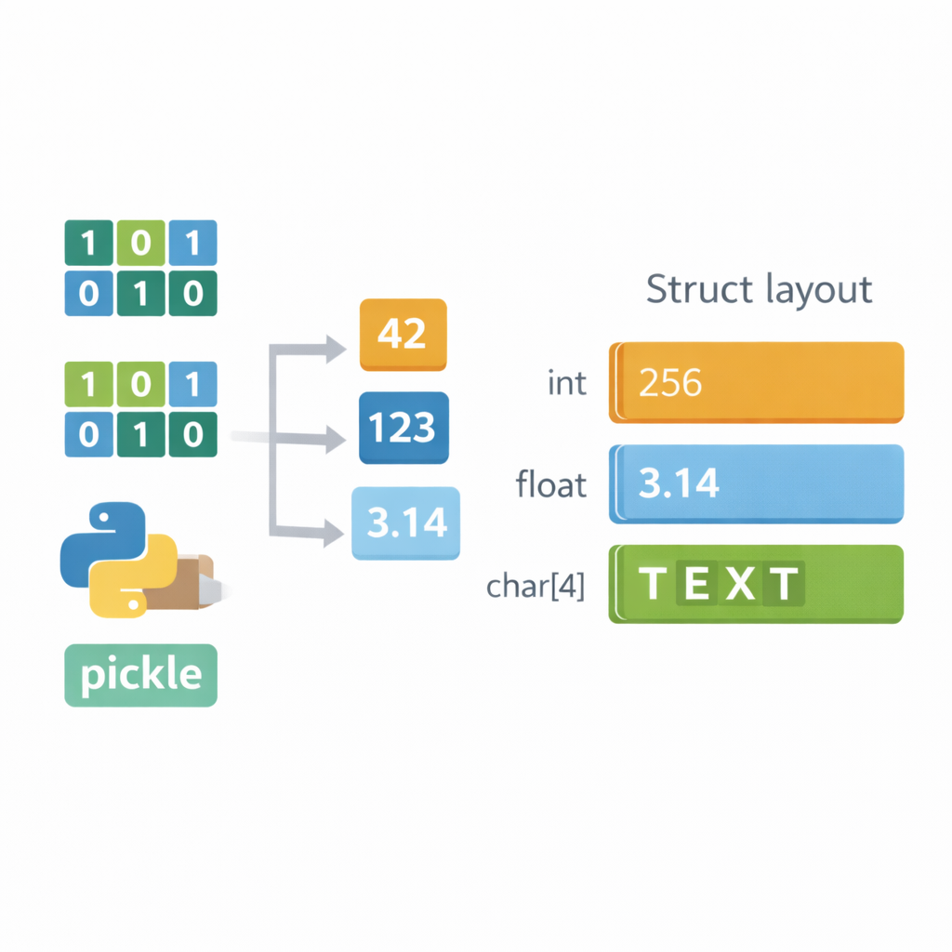
Binary Data & struct
Working with raw bytes and memory layouts.
Binary data is compact and fast
struct packs/unpacks bytes into values
Used in networking, hardware, file formats
Requires strict format agreements
Errors are subtle and hard to debug
Notes:
Explain that binary formats trade readability for performance. Students don’t need mastery—just awareness and caution.

Slide 8
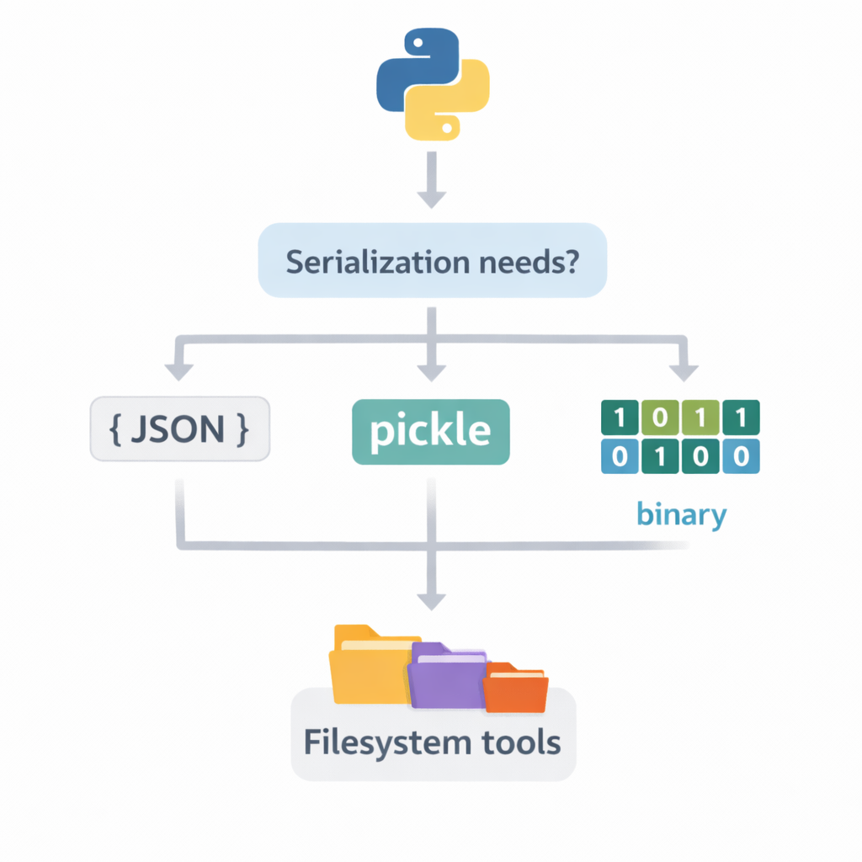
Choosing the Right Tool
Different persistence problems require different solutions.
JSON → configs, APIs, interoperability
Pickle/Shelve → quick Python-only storage
Filesystem tools → organization & automation
Binary → performance-critical systems
Design decisions matter more than syntax
Notes:
Tie everything back to design intent. Ask: Who reads this data? For how long? How safely?

Slide 9
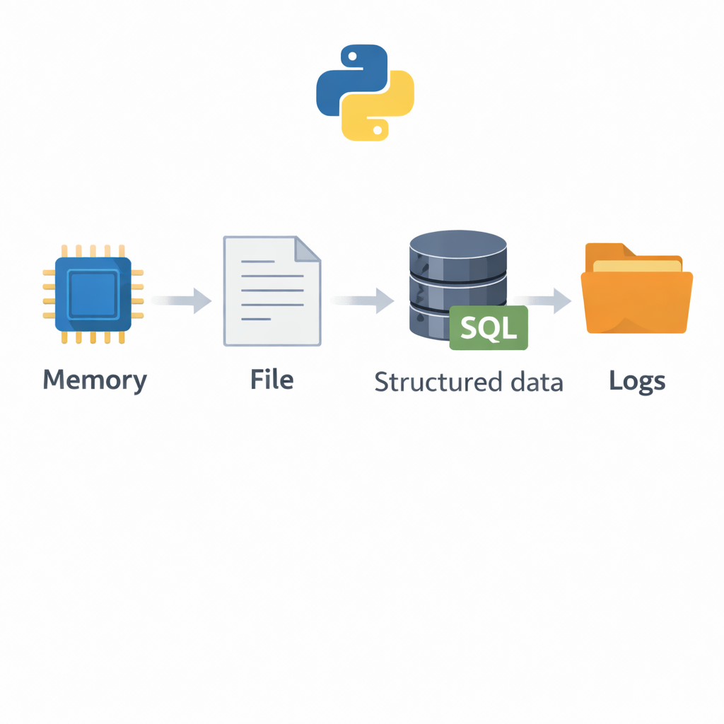
Session Wrap-Up
Persistence is a design responsibility, not an afterthought.
Filesystem interaction introduces real-world failure modes
Serialization shapes system boundaries
Safety and maintainability outweigh convenience
Python provides tools at every abstraction level
Next step: combining persistence with exceptions & logging
Notes:
Prepare students for the next lab where exceptions and logging meet file systems. Reinforce that persistent bugs are worse than transient ones.

